Slide 1
Product Descriptions with AI In Production
By: Patrick Ayers

Slide 2
PREVIOUSLY ON COMP 4449 CAPSTONE

Slide 3

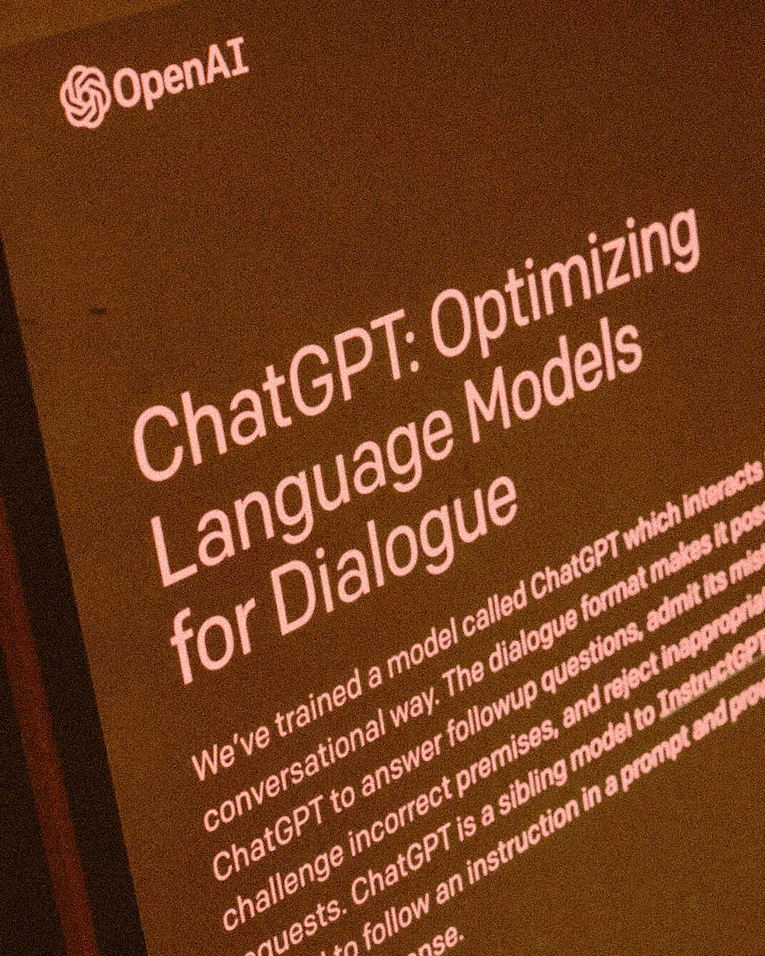

Slide 4
Part Two: Product Descriptions with AI In Production

Slide 5
Background Information
Who is Open AI?
OpenAI is a research and deployment company focusing on AI. They have made many great AI models in the last year.
ChatGPT => Optimize language models for dialogue
Dall-E2 => image classification and generation
openAI codex => Natural Language to code
What model from Open AI did I use?
ChatGPT API was not available at the time of this analysis, so I needed to use a GPT-3 model called text-davinci-003.
What was completed and learned in part one
1.Generate product description using OpenIA
2.Compare the models with each other using sequencem matching and sentiment analysis
3.The cost of using chatGPT was less then $10 for 4.5Krequest

Slide 6
Outline of Presentation
Database adjustments
Table additions
Information gained
Features implementation
Grammar fixing
Text analysis for readability
Choosing the write product description
Final process walkthrough
Next step in the process

Slide 7
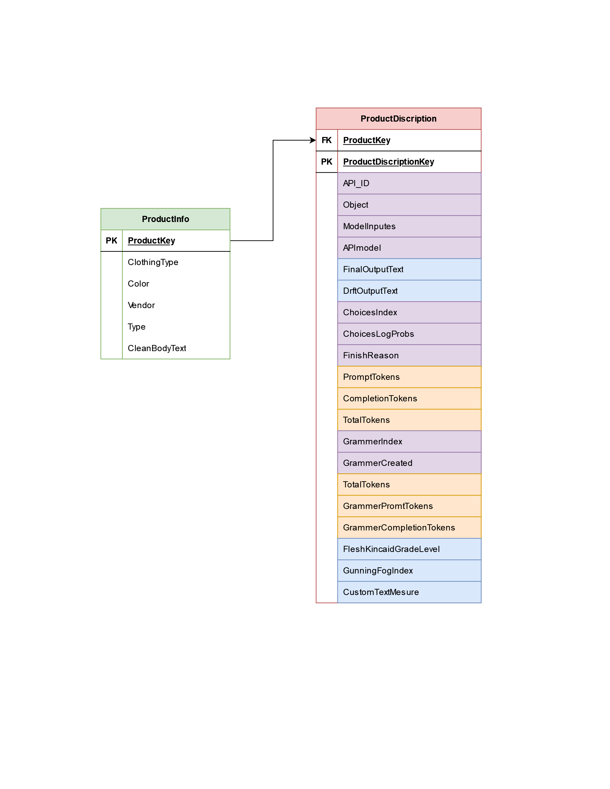
Database Addition
We have added a new table called Product Descriptions
Purple Cells are just metadata related to text generation and parameters
Orange cells are related to the number of tokens that were used to make the API call. This is all related to cost
Blue cells are the most critical.
Final output, this is after first tent generation and fixing grammar
Draft output, this is the text that is returned after the first API call
Flesh Kincaid Grade level Gunning fog index are used to measure the overall complexity of the text
Customer text measure is a value that is used to judge the quality of the text that is generated.

Slide 8
Features Implementation

Slide 9
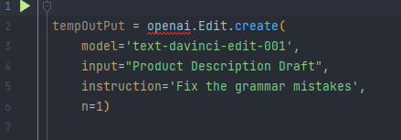
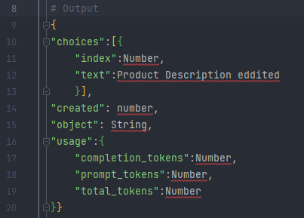
Correction of Grammar
Fixing the Grammar is being completed with OpenAI editor tool
Using the same model that was used for the draft of the product description
Instruction of fixing the grammar mistakes
N is the number of attempts
It will return a diction of metadata
Choices => text will be the product description after the grammar has been fixed
Usage is a cost information

Slide 10


Writing Complexity Metrics
Flesh Kincaid Grade Level
Gunning Fog Index
$\left(206.835\right)−1.014\left(\frac{Total words}{Total Sentences}\right)−84.6(\frac{Total syllables}{Total Words})$
Scores are bounded between 100 and 0
The lower the number, the more complex it will be to understand.
College level will have a score of 50 - 30
8th/9th grade will have a score of 70 – 60
$0.4[\left(\frac{words}{sentences}\right)+100\left(\frac{Complex words}{Words}\right)]$
Scores are between 0 and 17
The higher the score, the more complex the writing will be
A score of 13 is suited for a college freshman
A score of 9 is suited for a high school freshman
These metrics have been added to ensure that the output of the product description is still readable for the average customer.

Slide 11

Product Description Quality Check
This is used in conjunction with the other two text analysis
This is not measuring the complexity of the text it measures the overall quality.
A value closer to zero implies a lower quality and unbalanced text.
$\left[\frac{\left(Unique Word Count\right)}{\left(Total Word Count\right)}\right]∗\frac{UDA Use Count}{\left(Number of UDA\right)}∗\left[\frac{\left(ADJ Count\right)}{\left(Total Word Count\right)}\right]$

Slide 12
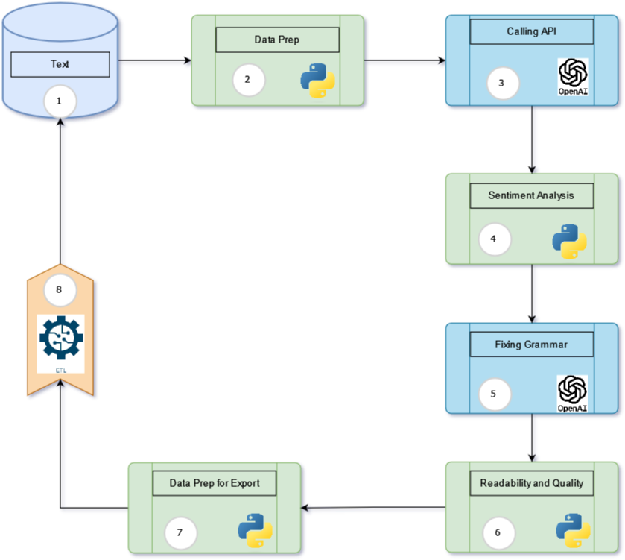
Final Process
Look for items that need a product description
Data prepping for calling API
Running both sequence and sentiment analysis
Running Sentiment analysis and string matching function
Calling grammar fixing functions
Running readability and quality analysis
Prepping data for exporting
Converting Json to Dataframe
ETL to load data into a stage table and then append it to the product table

Slide 13
Next Step
Reaching out to an e-commerce company to allow us to run this process on company data.
This would allow us to try the process on live data and would also give access to other information that can give insight into how successful the model is
Customer engagement
SOE analysis
A/B testing

Slide 14
Thank You

Slide 15
Questions

